Slide 1
Sensing human activity with dark light
Hajo Kleingeld
Supervisor: Marco Zuniga

Slide 2
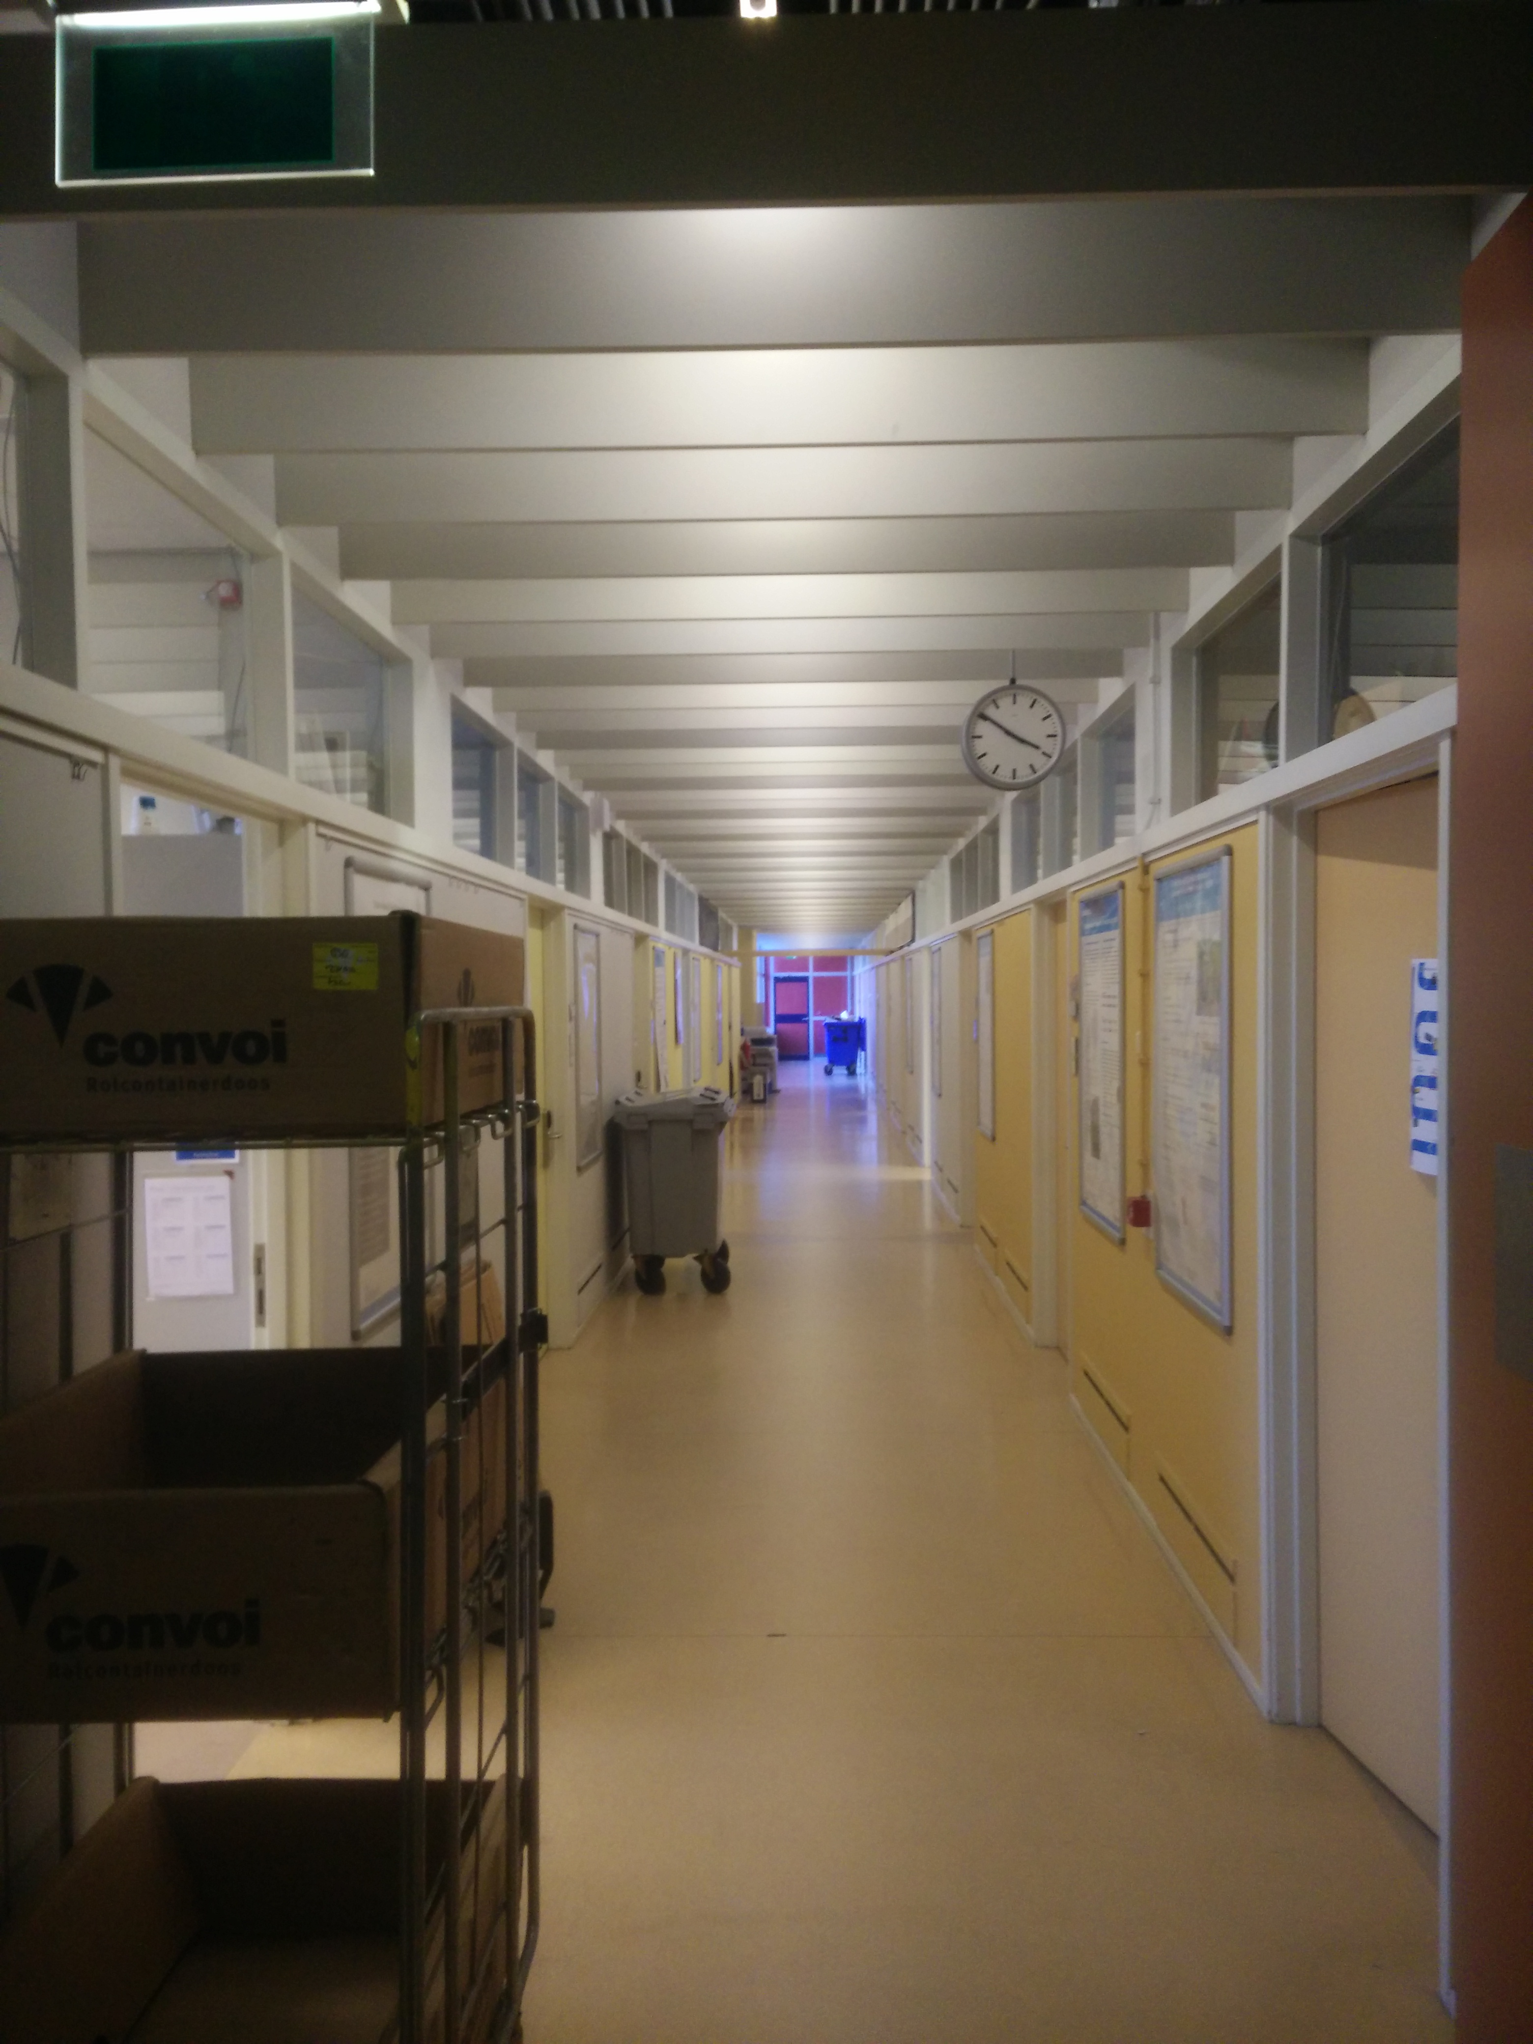
Notes:
If you look at this hallway, the lights are all on. But nobody is there, so all light is wasted....
Different ways to do this

Slide 3
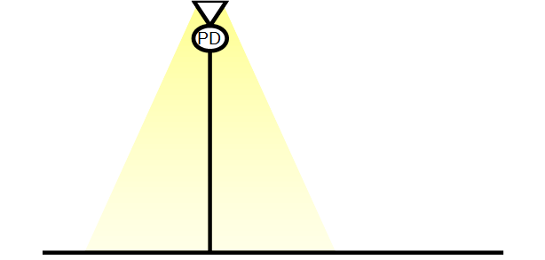

Slide 4


Slide 6
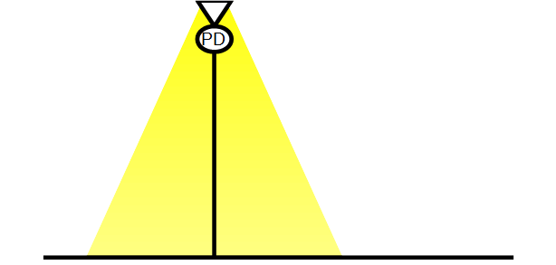
Notes:
So how are we going to dim the light

Slide 7
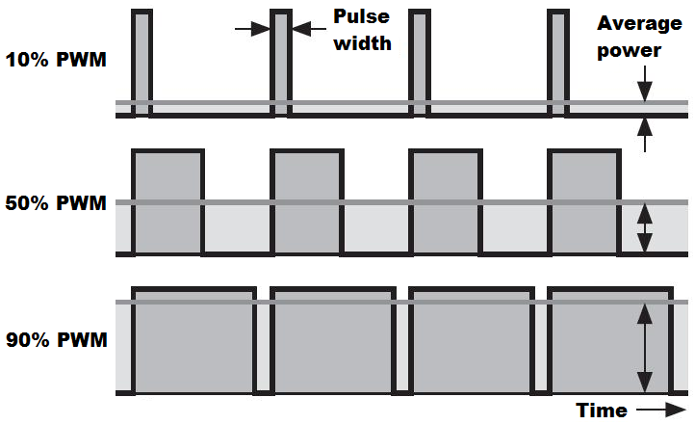
Reducing the light output
Notes:
There are two ways to controll the amount of light outputed

Slide 8
Goals
Detect human activity
Short flashes
Reflections
Save light → Save energy!

Slide 9
Overview
Detection or no detection
LED
Receiver
Data
Algorithm
Light
Reflection
Environment

Slide 10
Overview
Detection or no detection
2
Data
3
LED
Receiver
Algorithm
1
Light
Reflection
Environment

Slide 11
Model
H = 280cm
Persons vary in:
Height
Path
Albedo
Notes:
Heigth, Albedo, vertical distance

Slide 12
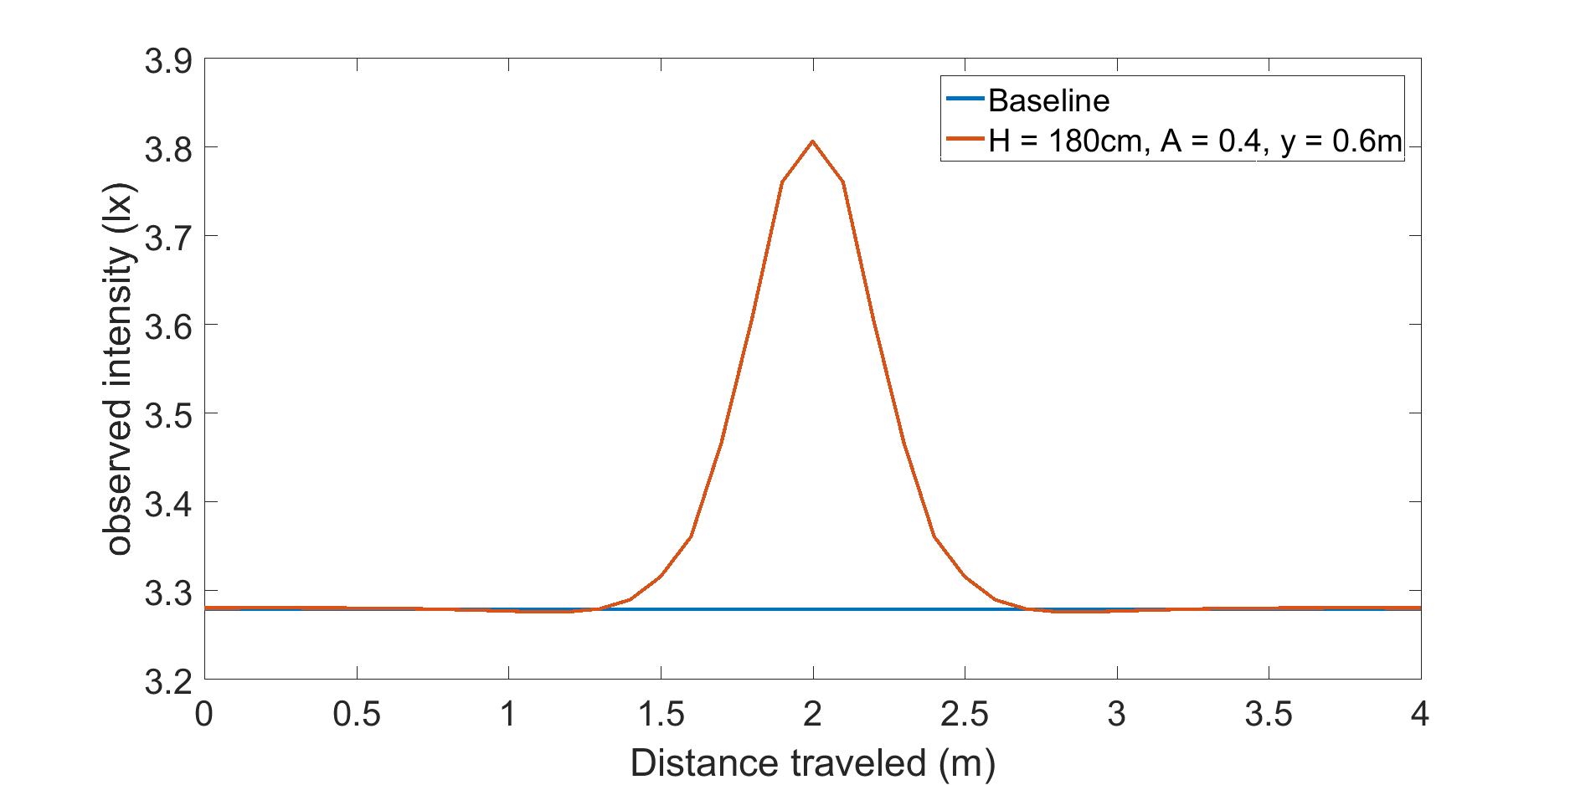
Model results
Notes:
First state steady state, then say that it can change, up or down
Better one super interesting case, than more trvial.

Slide 13
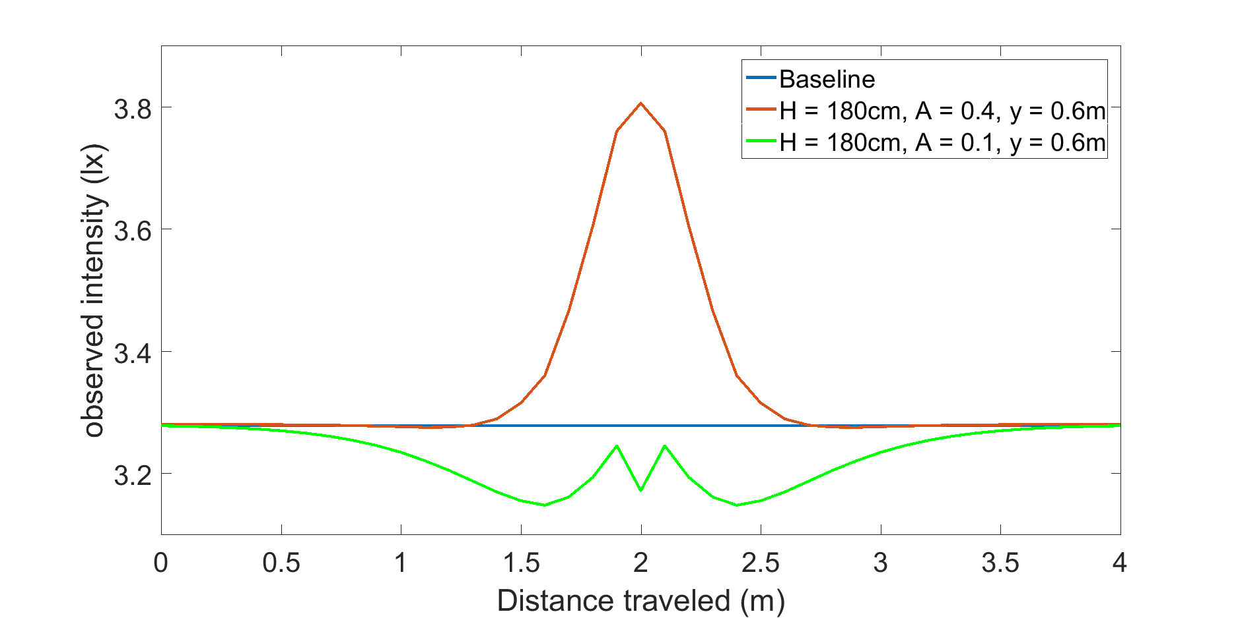
Model results
Notes:
First state steady state, then say that it can change, up or down
Better one super interesting case, than more trvial.

Slide 14
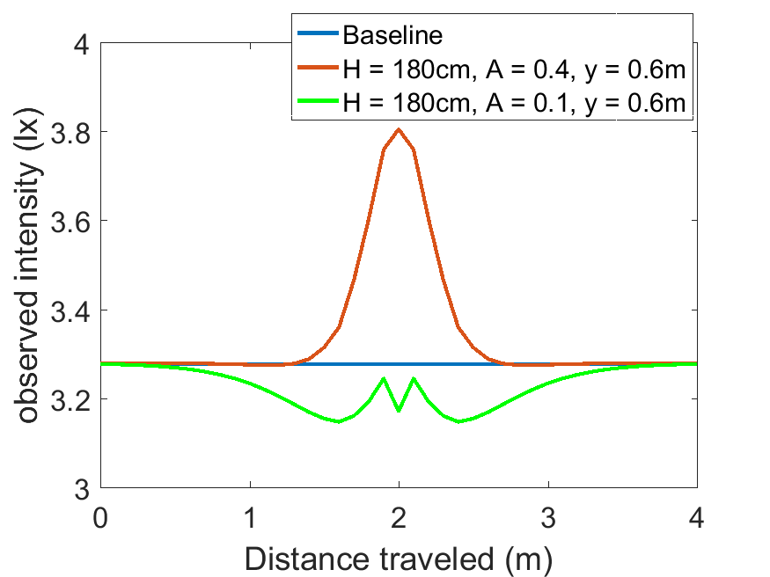
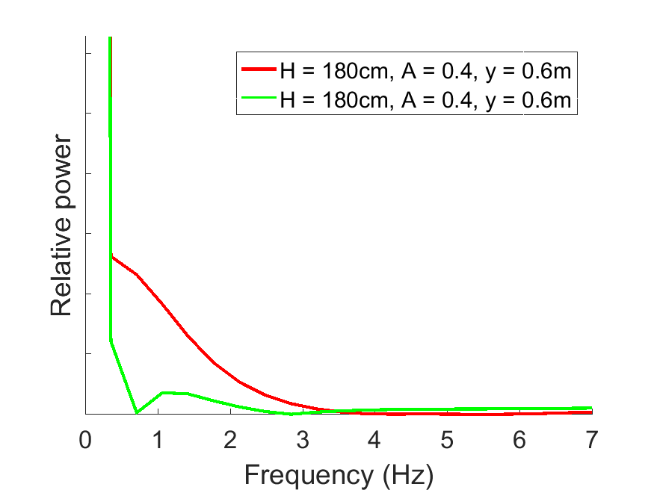
Model results
Notes:
Two key message”s: different pulses and frequency spectrum

Slide 15
Overview
Detection or no detection
2
Data
3
LED
Receiver
Algorithm
1
Light
Reflection
Environment
Notes:
Best environment representation with the least amount of noise

Slide 16
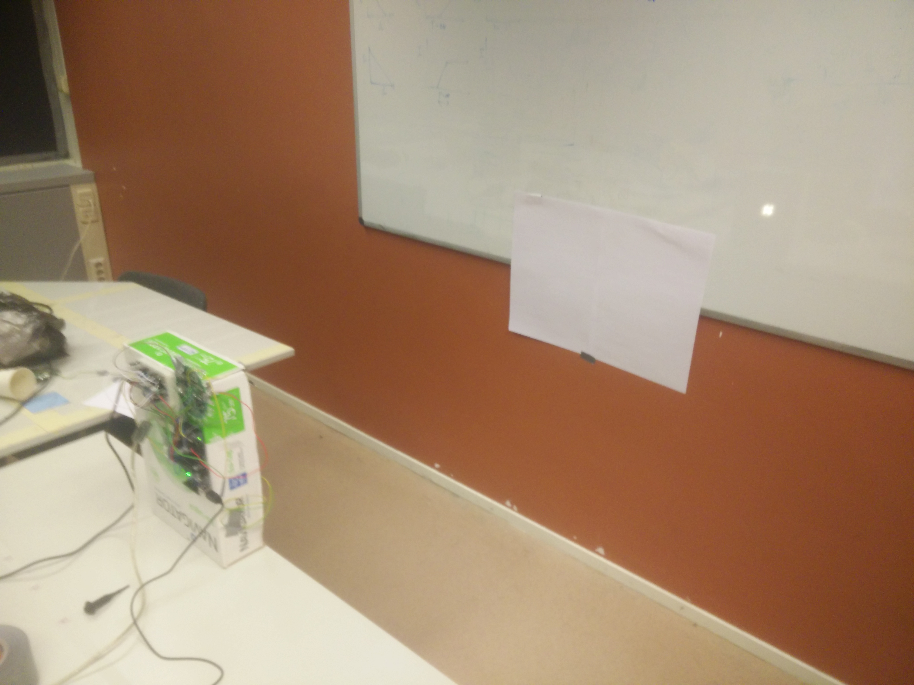
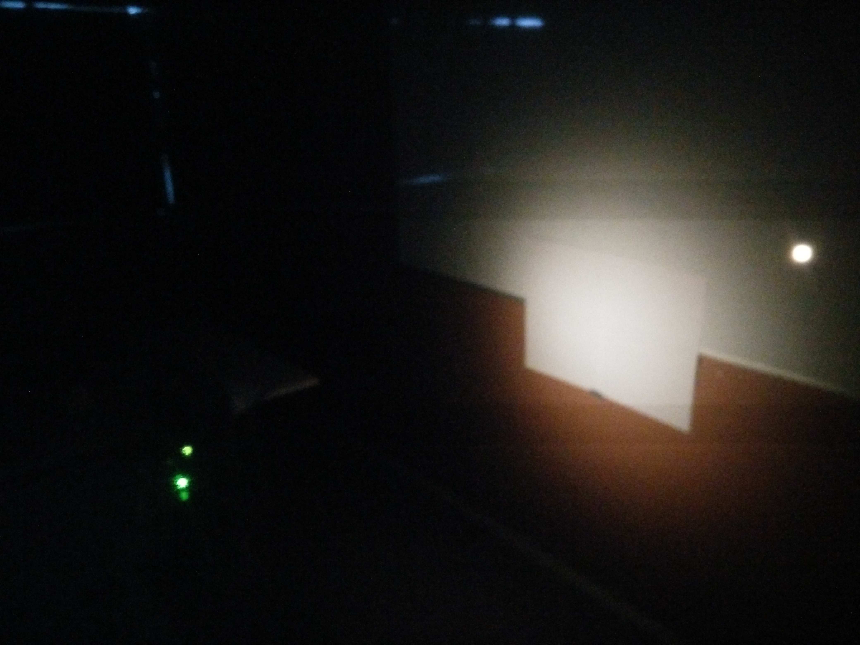
Test setup
Settings:
Intensity
Sensitivity
T-on
Features

Slide 17
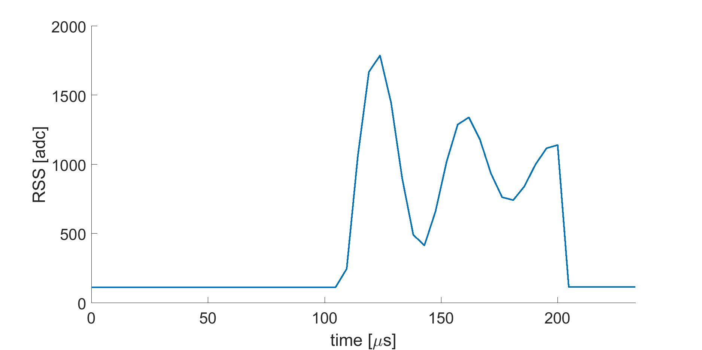
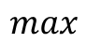
Flash features
$$max$$

Slide 18
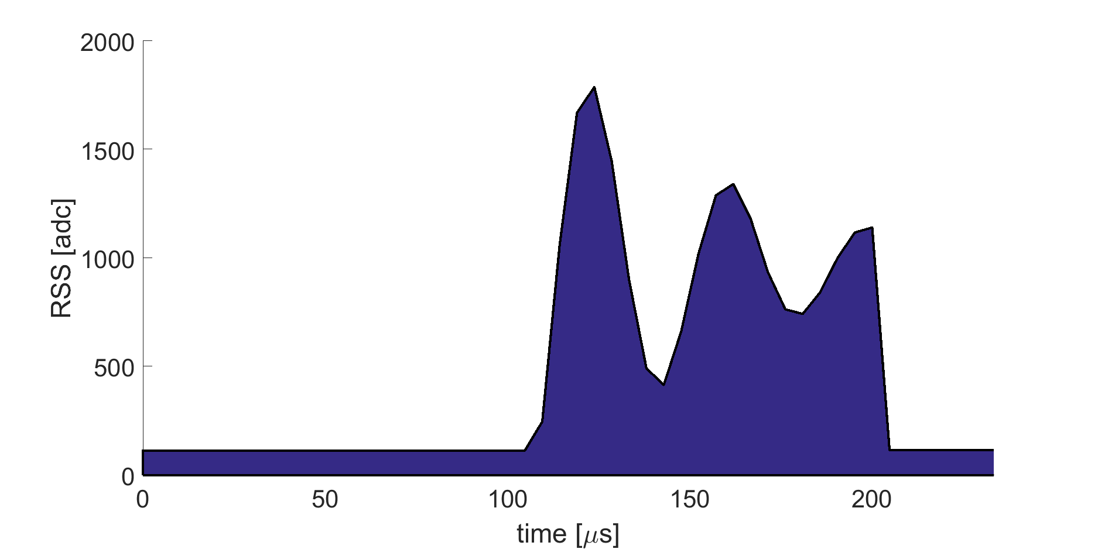
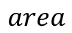
Flash features
$$max$$
$$area$$

Slide 19
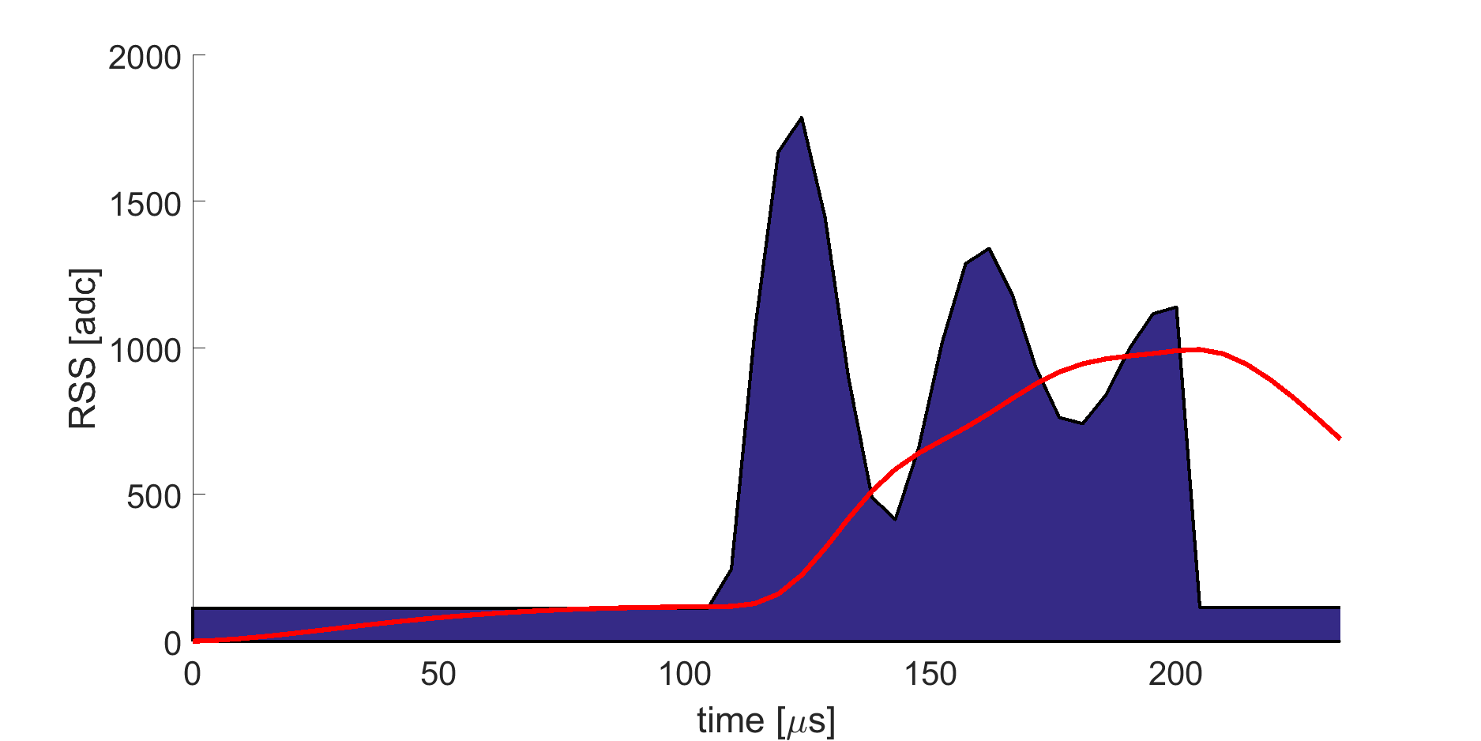
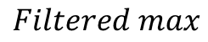
Flash features
$$max$$
$$area$$
$$Filtered max$$

Slide 20
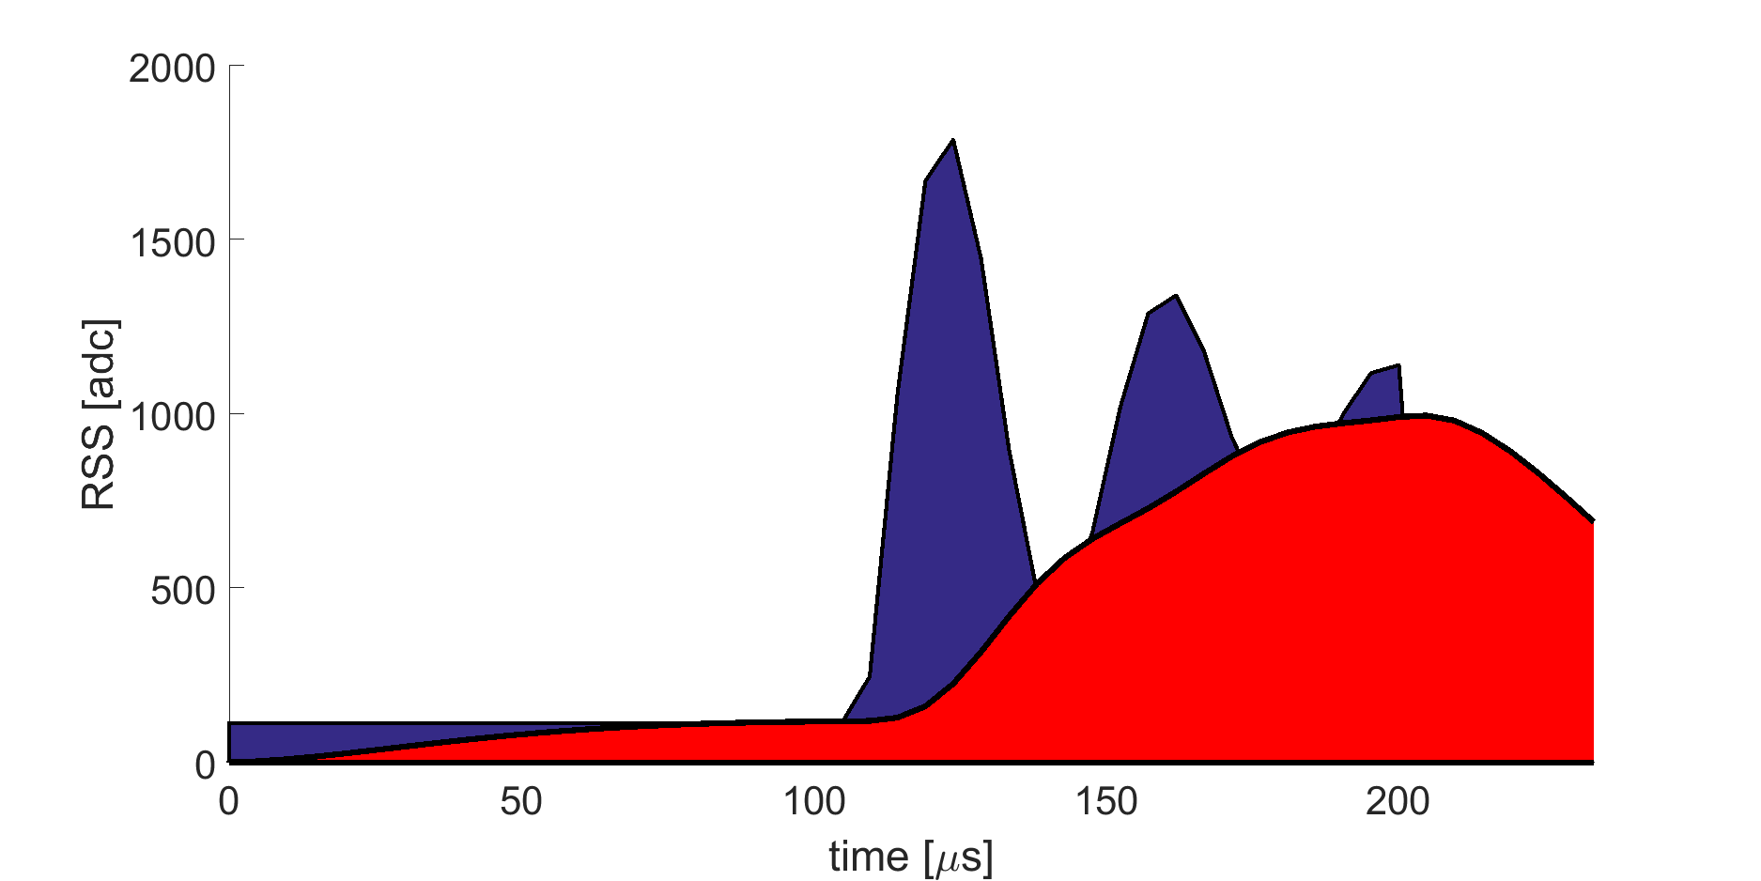
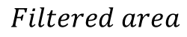
Flash features
$$max$$
$$area$$
$$Filtered max$$
$$Filtered area$$

Slide 21
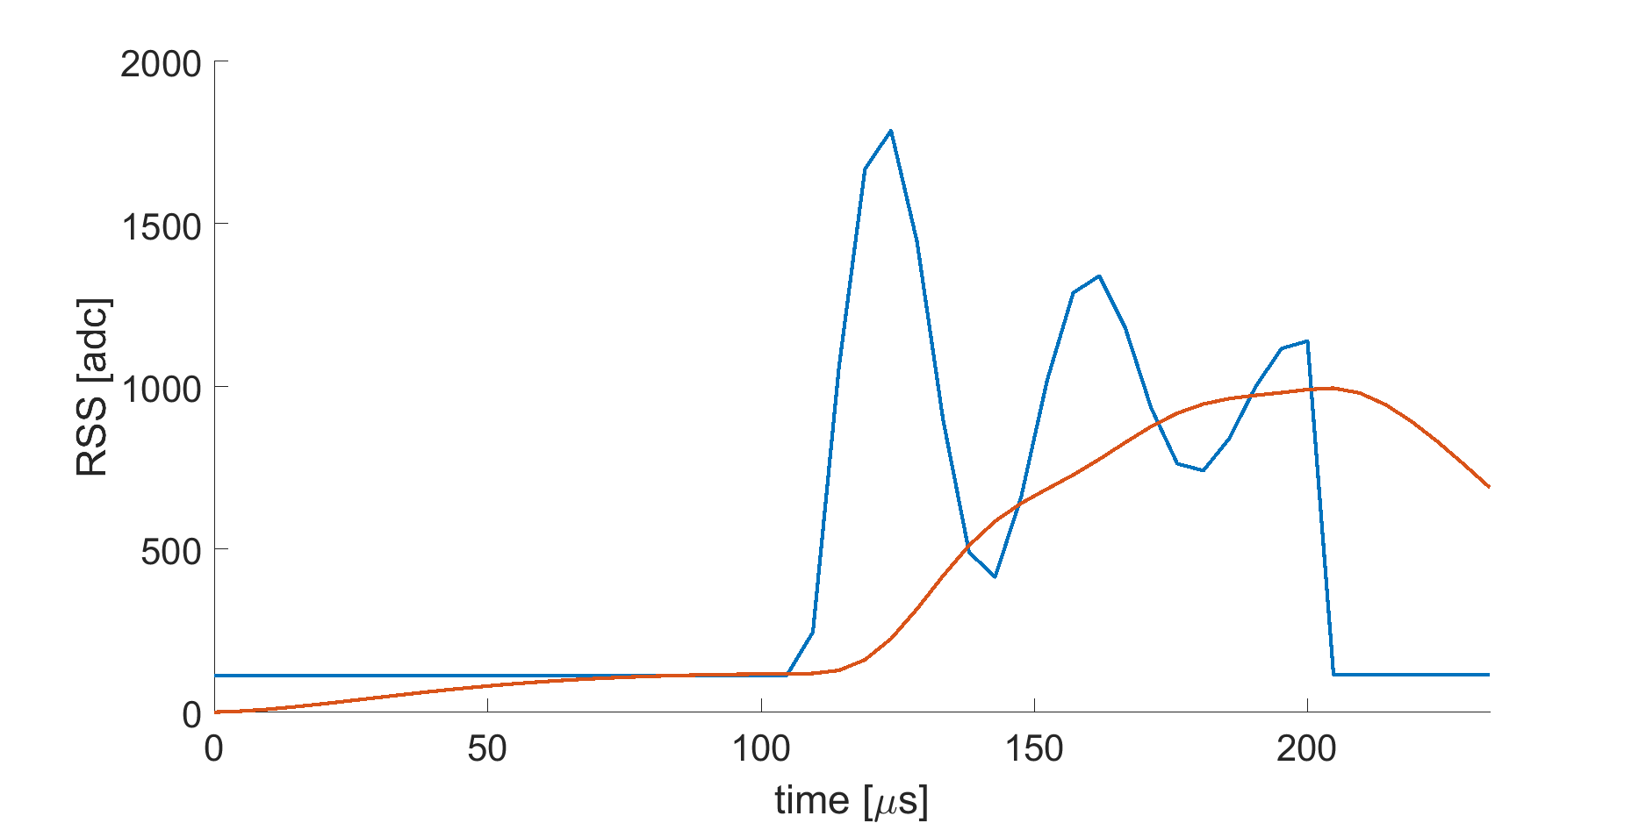
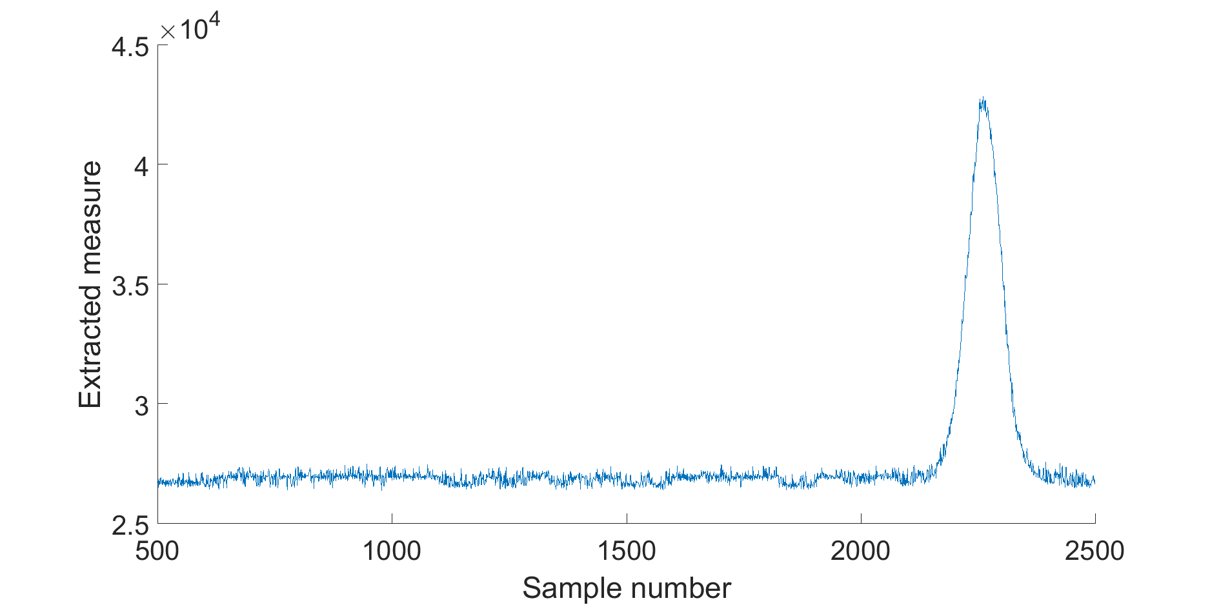
Consecutive flash features

Slide 22
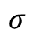
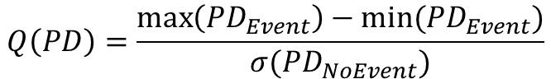
Consecutive flash features
$$Q\left(PD\right)=\frac{\max\left(PD_{Event}\right)−min⁡(PD_{Event})}{σ(PD_{NoEvent})}$$
$$σ$$

Slide 23
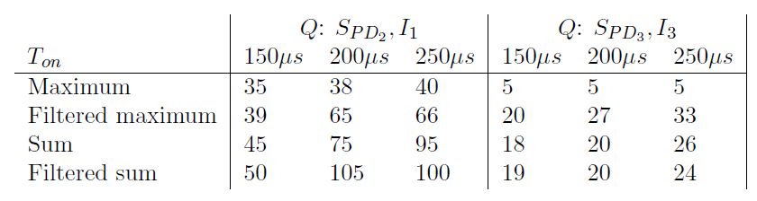
Results
Bright light,
normal sensitivity
Low light,
High sensitivity
Notes:
Q = Worse when less light is used
Best method is filtered sum

Slide 24
Overview
Detection or no detection
2
Data
3
LED
Receiver
Algorithm
1
Light
Reflection
Environment

Slide 25
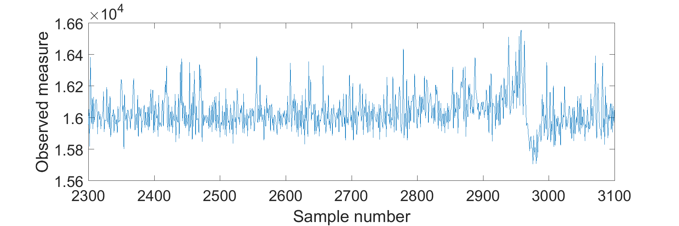
Noise sources

Slide 26
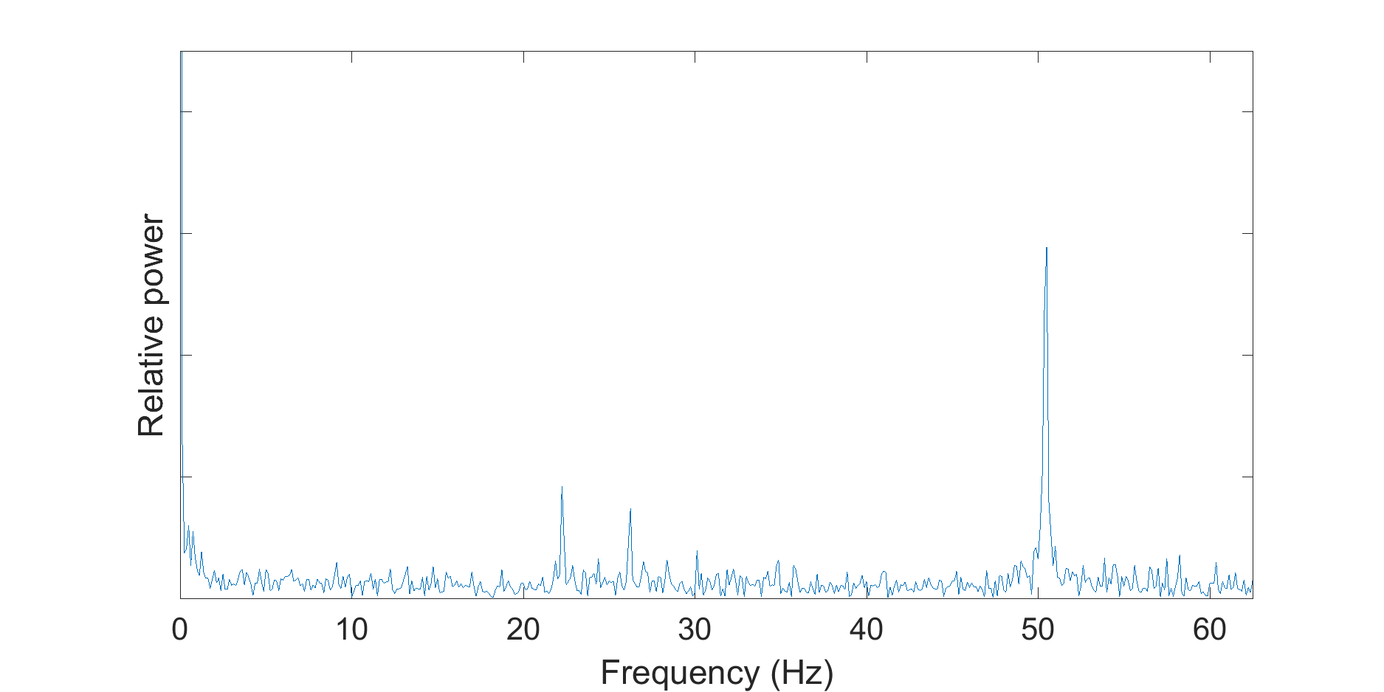
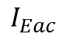
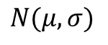
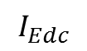
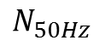
Noise sources
$$I_{Edc}$$
$$N_{50Hz}$$
$$I_{Eac}$$
The
signal
$$N(μ,σ)$$

Slide 27
Lowpass filter
Highpass filter
Moving average

Slide 28
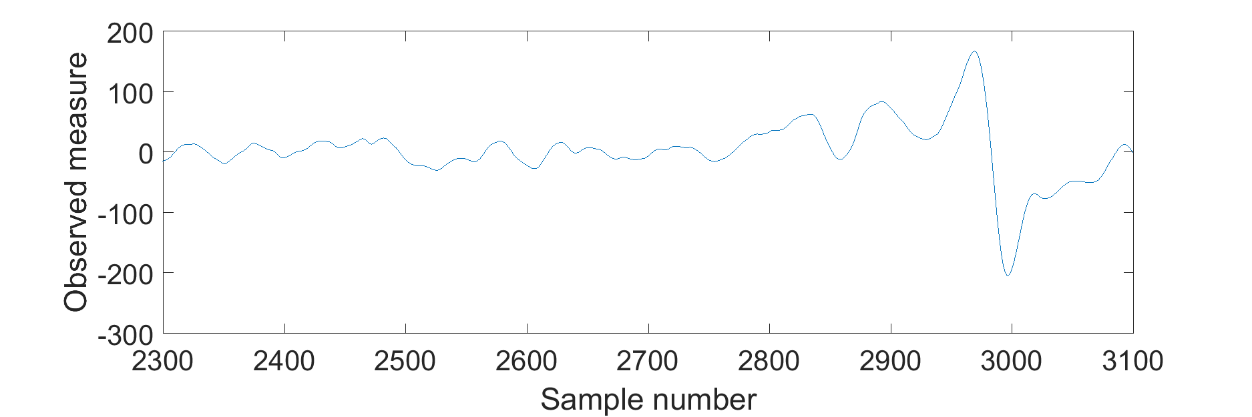
Notes:
How do we determine the threshold, to clasify the data with?

Slide 29
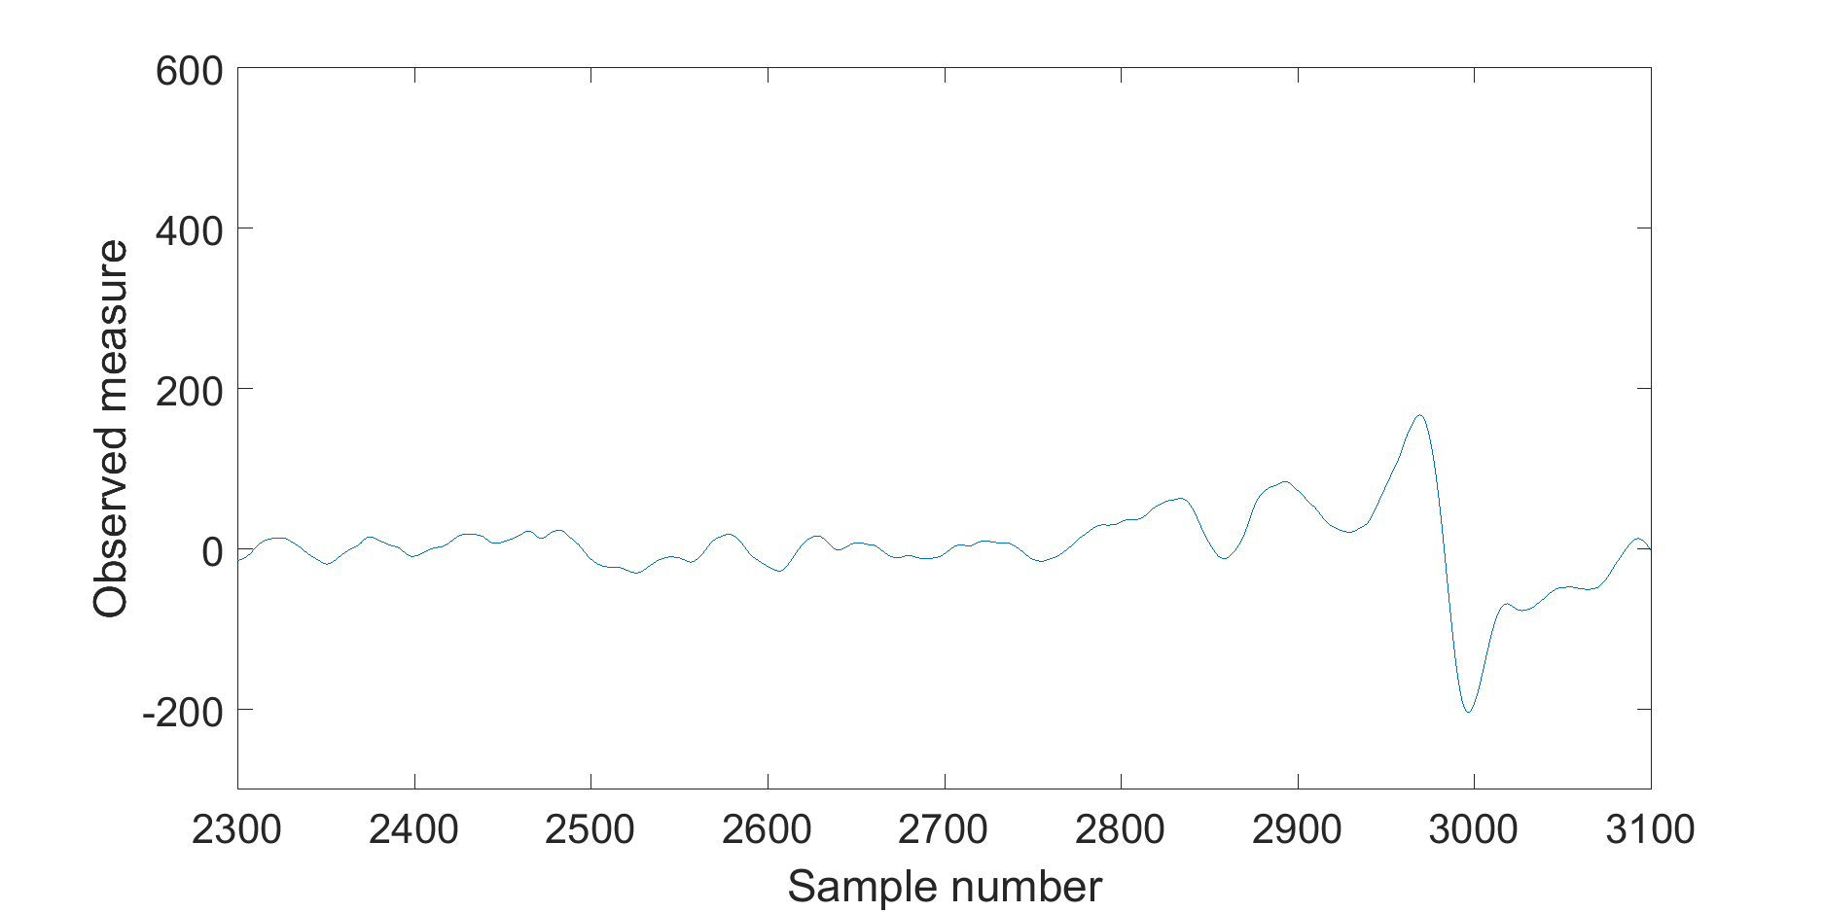

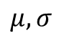
Threshold: $X>μ±T⋅σ$
$$μ,σ$$

Slide 30
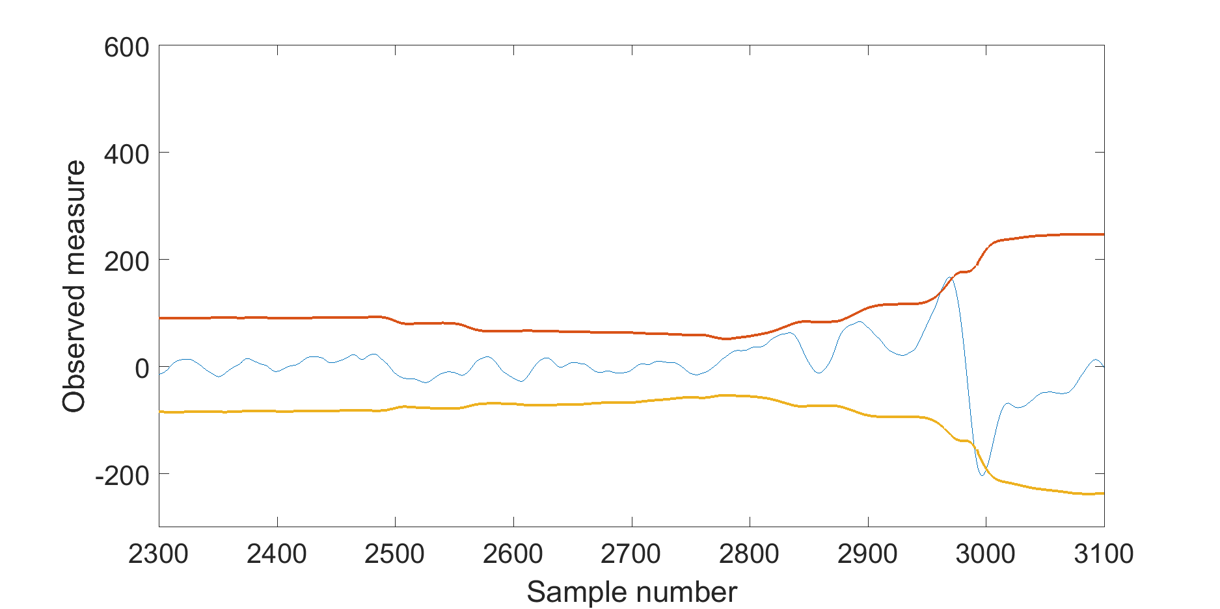
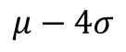
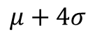
Threshold: $X>μ±T⋅σ$
$$μ,σ$$
$$μ+4σ$$
$$μ−4σ$$

Slide 31
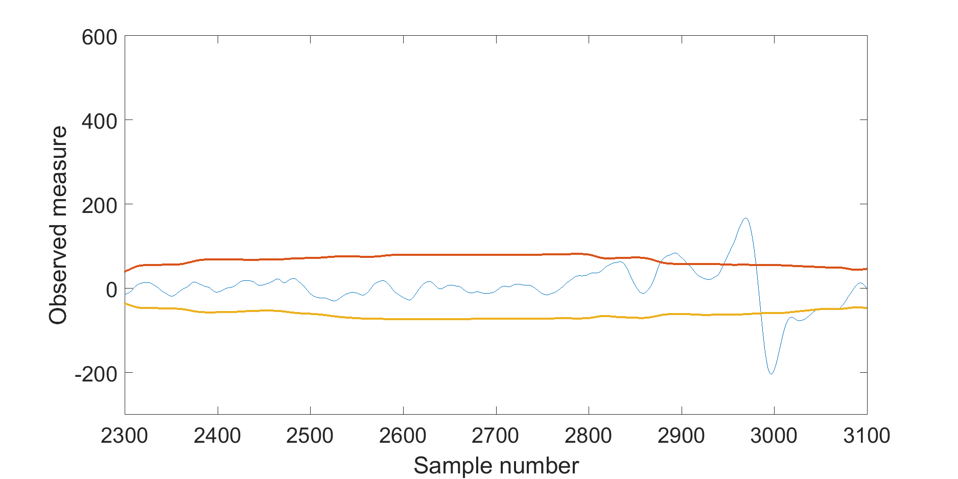
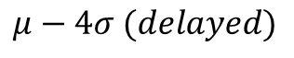
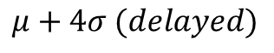
Threshold: $X>μ±T⋅σ$
$$μ+4σ (delayed)$$
$$μ−4σ (delayed)$$

Slide 32
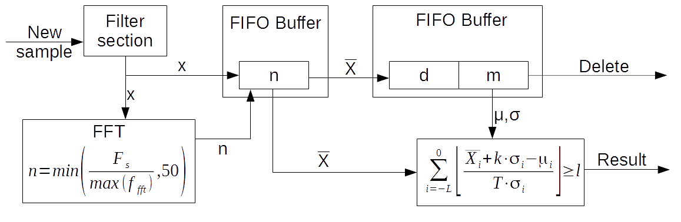
Algorithm overview

Slide 33
Genetic algorithm
Train two versions
Wooden floor
Carpet
Dataset
Fitness function

Slide 34
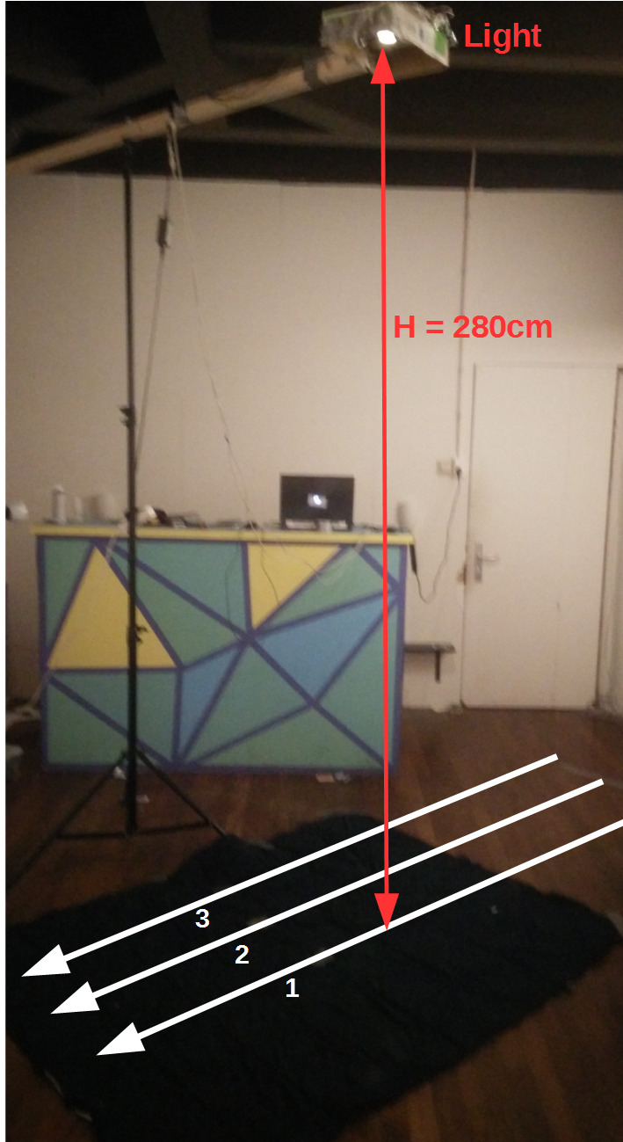
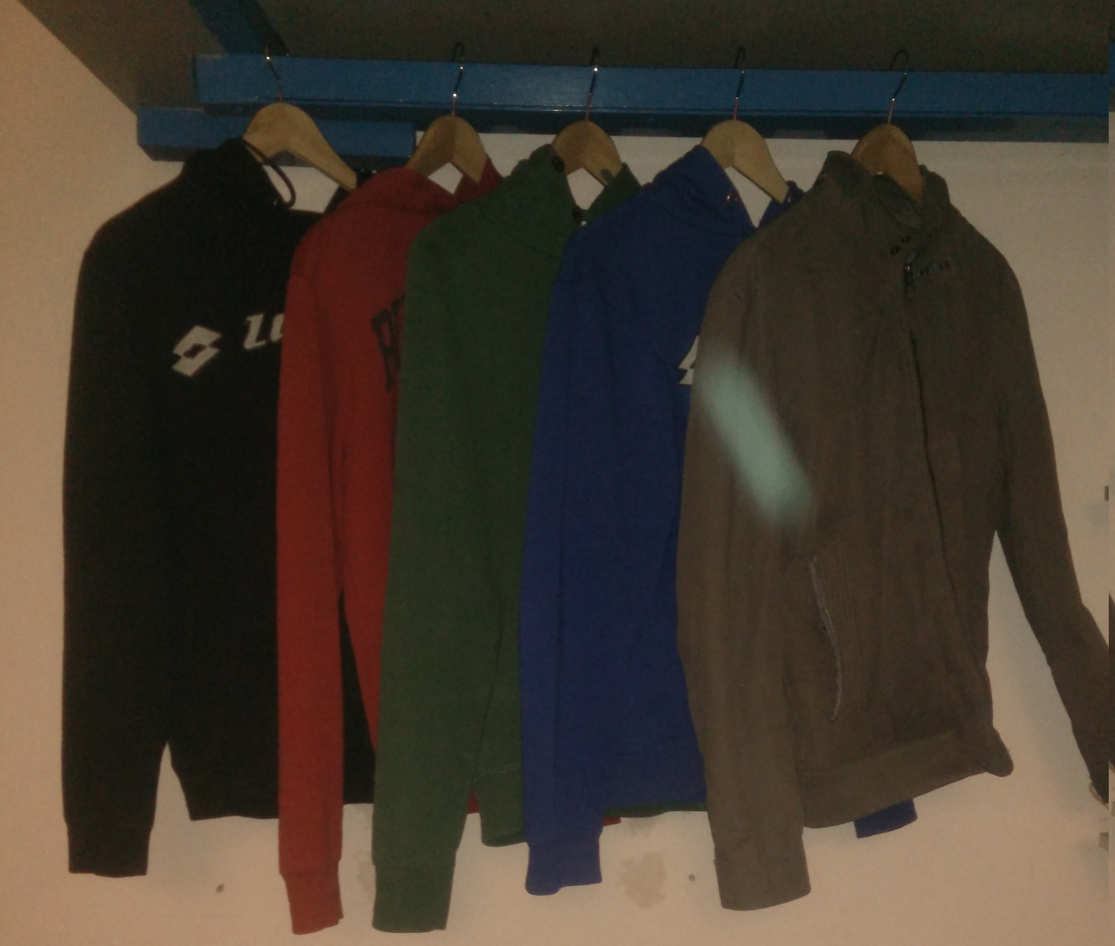
Dataset
2 Floors
3 Lanes
5 Colours
6 Tries each

Slide 35
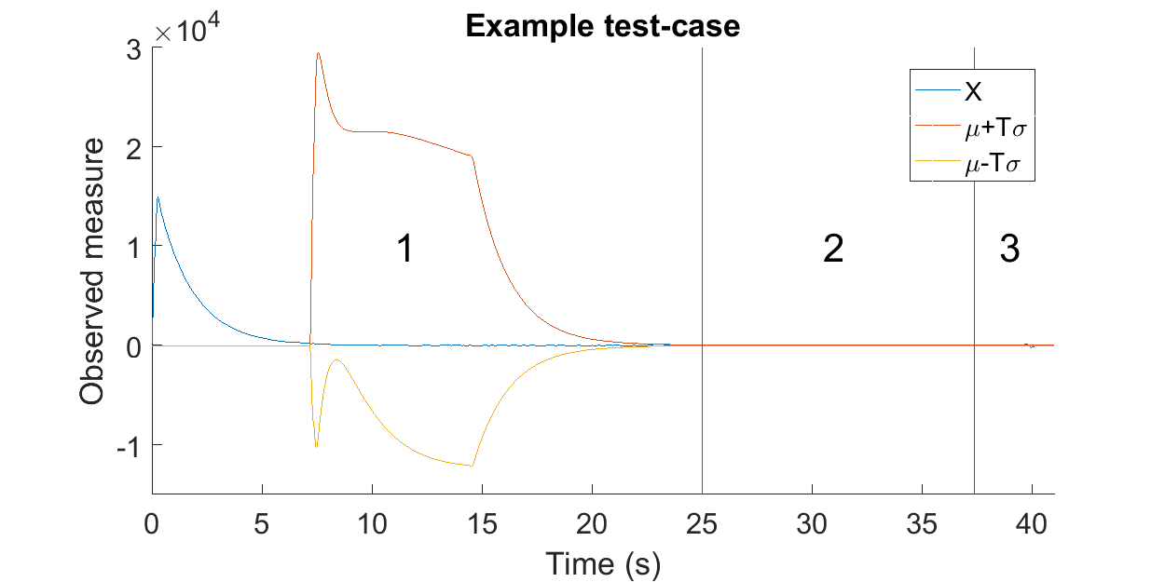
Fitness function
Initialisation
Check for FP
Check for TP

Slide 36
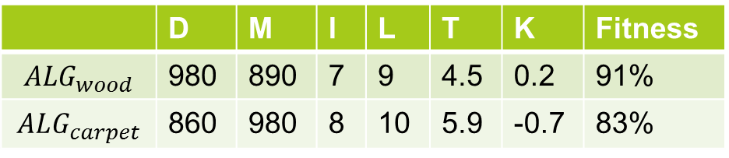
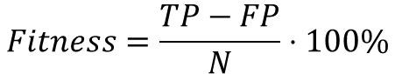
Training results
$$Fitness=\frac{TP−FP}{N}⋅100\%$$
 | D | M | l | L | T | K
Min | 0 | 1 | 1 | 1 | 1 | -1
Max | 1000 | 1000 | 10 | 10 | 10 | 1
 | D | M | l | L | T | K | Fitness
$$ALG_{wood}$$ | 980 | 890 | 7 | 9 | 4.5 | 0.2 | 91%
$$ALG_{carpet}$$ | 860 | 980 | 8 | 10 | 5.9 | -0.7 | 83%

Slide 37
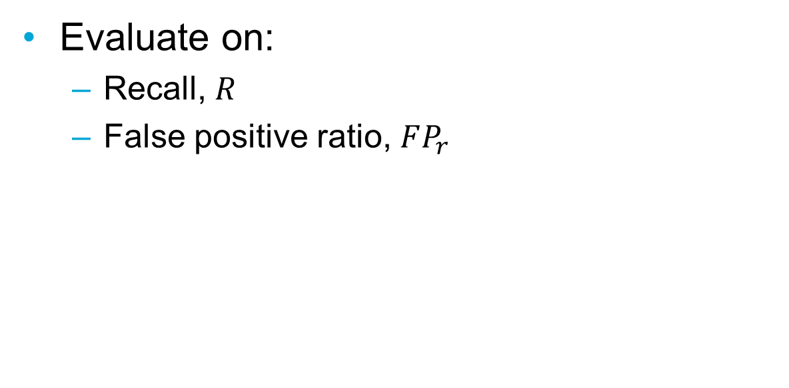
Evaluation metrics
Evaluate on:
Recall, $R$
False positive ratio, $FP_{r}$

Slide 38
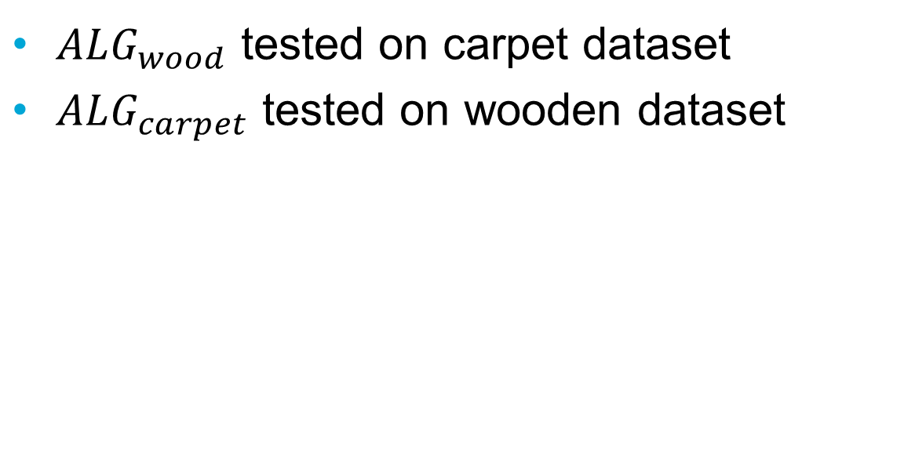
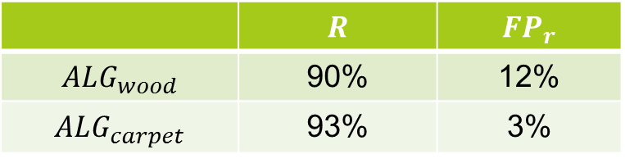
Cross evaluation
$ALG_{wood}$ tested on carpet dataset
$ALG_{carpet}$ tested on wooden dataset
 | $$R$$ | $$FP_{r}$$
$$ALG_{wood}$$ | 90% | 12%
$$ALG_{carpet}$$ | 93% | 3%

Slide 39
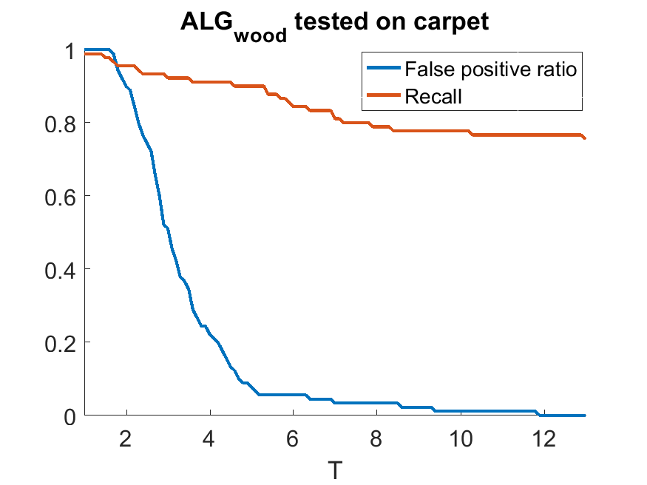
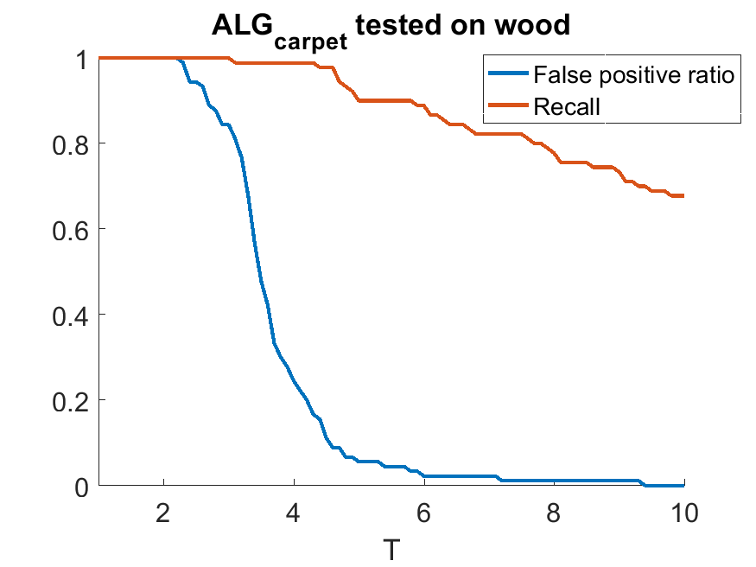
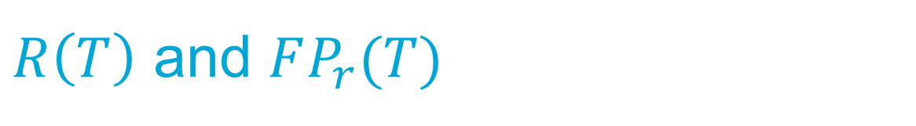
$R\left(T\right)$ and $FP_{r}(T)$

Slide 40
Overview
Detection or no detection
2
Data
3
LED
Receiver
Algorithm
1
Light
Reflection
Environment

Slide 41

Results

Slide 42

Results

Slide 43

Conclusions
Proved the feasibility of Dark Sensing
Saved $±$96% of light (flash settings)
Achieved:
73% recall w$ith FP_{r}=0\%$
90% recall w$ith FP_{r}=5\%$

Slide 44
Future work
Improve electronics
Scale the system
Communication between the two systems

Slide 46


$$μ±T⋅σ$$

Slide 47

$$μ±T⋅σ$$

Slide 48


Slide 49


Slide 50






Slide 51



Slide 52



Slide 53


Slide 54



Slide 55



Slide 56


Slide 57



Slide 58



Slide 59


Slide 60


Slide 61


Slide 62


Slide 63


Slide 64


Slide 65


Slide 66



Slide 67



Slide 68



Slide 69


Slide 70

Algorithm overview
m | Lenght of $μ,σ$ window
d | Delay of the $μ,σ$ window
T | Threshold scale factor ($T⋅σ$)
k | Threshold offset
l/L | Threshold voting system

Slide 71


